Slide 1


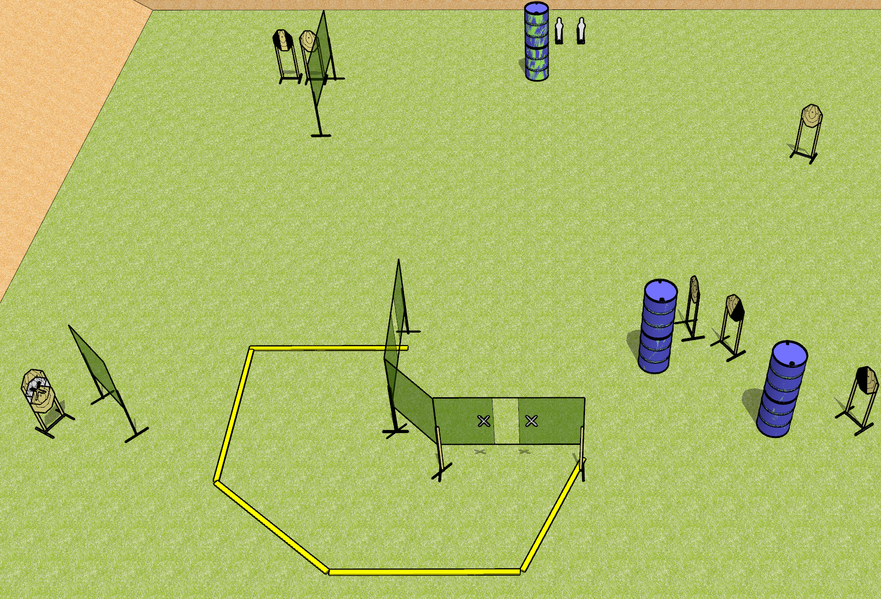
 | Dothan Gun Club – USPSA Match Justified Course Designer : Drew Coleman
Round Count 18 rounds 8 IPSC 2 mini poppers
Equipment List 10 wall feet 1 left + 1 right diag, 1 tux, 6 targets (5 + 1 NS)

Slide 2
Justified
Written Stage Briefing
Scoring: Comstock
Targets: 8 IPSC, 2 poppers
Rounds: 18
Handgun start position: hands touching upper marks. Handgun is UNLOADED and holstered.
PCC start position: muzzle touching lower mark, stock on belt. Carbine is UNLOADED.
Stage Procedure: on the audible start signal, engage targets as they become available from within the shooting area.

